Slide 1
Open PMIC
Design Review
Weston Braun
Aparna Tumkur
Github: https://github.com/westonb/open-pmic

Slide 2
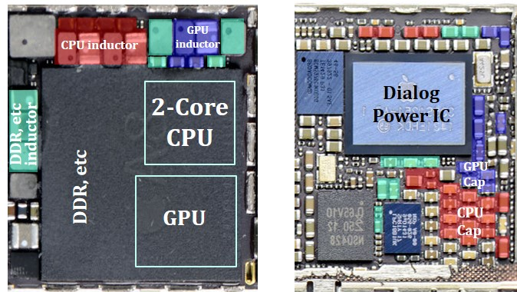
Project Motivation
Develop an open source buck (step down) converter for integration into other projects on the SKY130 PDK
Generate core logic voltage (1.8V) from I/O supply (3.3V)
Reduce system power consumption
Increased integration and reduced PCB complexity
https://cpes.vt.edu/library/viewnugget/623

Slide 3
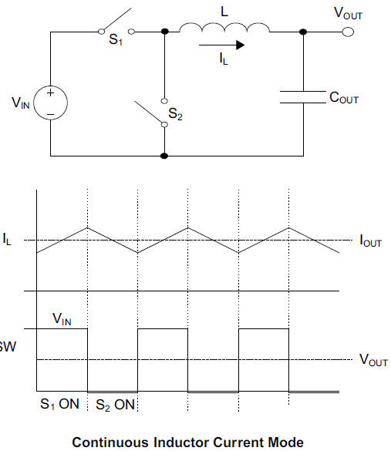
Current Mode Buck Converter Theory
Two switches chop up input voltage and LC filter reconstructs voltage to average value
More stable from a control prospective if control loop regulates inductor current
Requires:
Error amplifier - sense output voltage
Current sensing circuit
Oscillator / modulator - generate switch drive signals
Power Stage
https://microchipdeveloper.com/desanl:synchronous-buck-converter-overview

Slide 4
Target Specifications
Nominal Vin | 3.3V
Vout | 1.8V ±5%
Maximum Output Current | 300mA
Switching Frequency | 300kHz
Efficiency | >85%

Slide 5
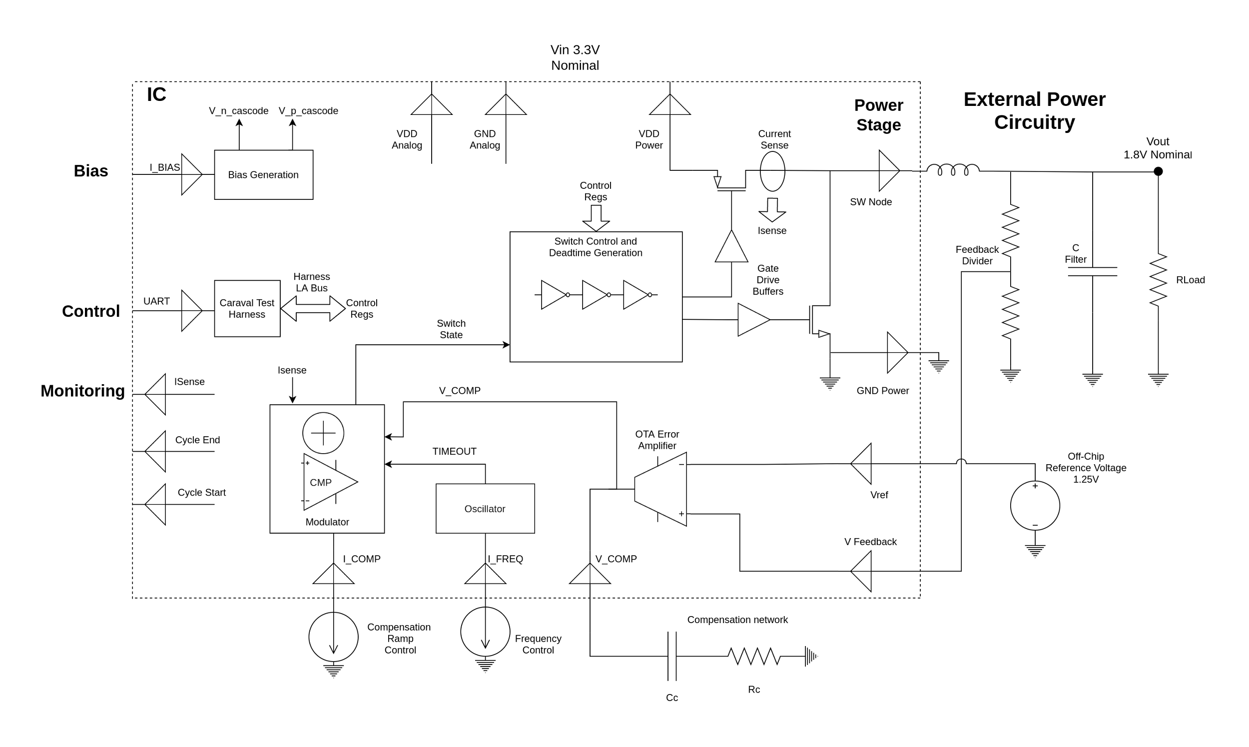
System Block Diagram
Power Circuitry
Support /
Debug
Control
Circuitry

Slide 6
Design Process
Functional Units
NMOS input opamp
PMOS input opamp
Bias Circuits
Power Stage
Comparator
Design Blocks
Modulator
Oscillator
Switch Control
Current Sense

Slide 7
Functional Units

Slide 8
Design Process
Functional Units
NMOS input opamp
PMOS input opamp
Bias Circuits
Power Stage
Comparator
Design Blocks
Modulator
Oscillator
Switch Control
Current Sense

Slide 9
NMOS Input Opamp
High bandwidth opamp for current sense circuitry
Input voltage range extends to positive supply rail
Implemented as folded cascode OTA
Externally Compensated through current sense circuit
Nominal Gm of 1.3 mmho
DC gain of 63dB

Slide 10
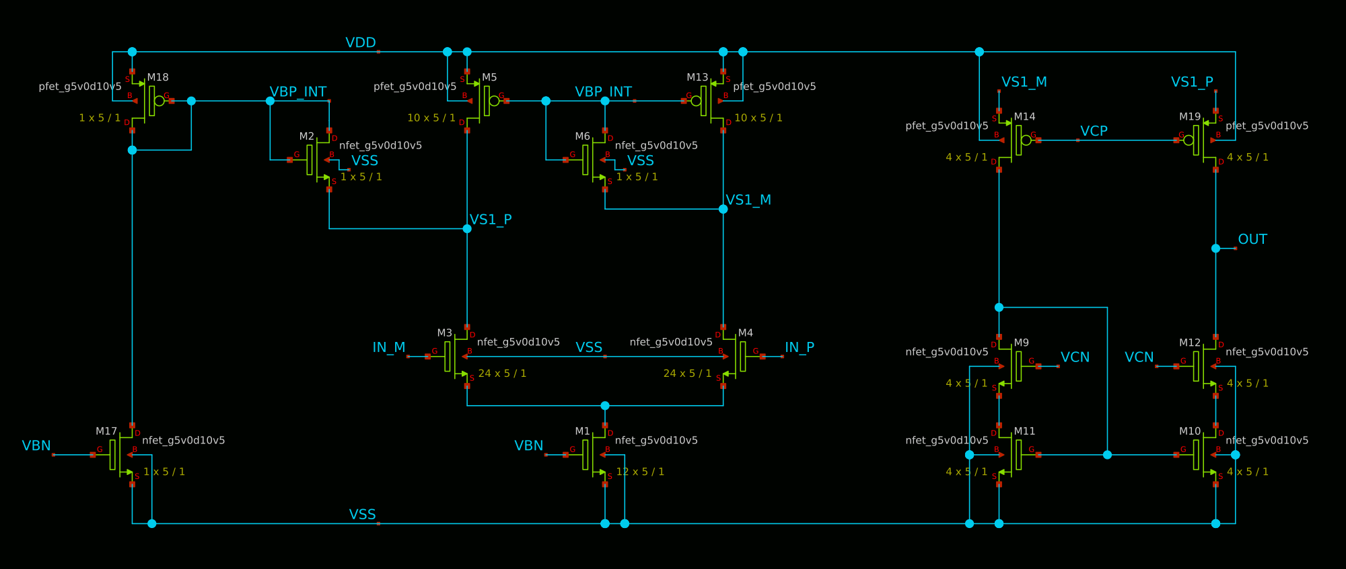
NMOS Input Opamp - Schematic

Slide 11
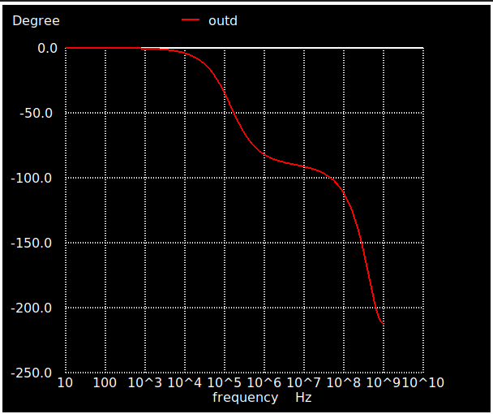
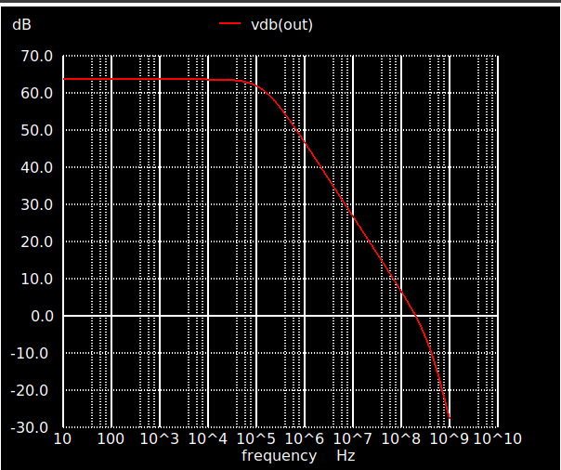
NMOS Input Opamp - Verification
Crossover Frequency of 160MHz and phase margin of 45 degrees with 1pF load capacitor

Slide 12
Design Process
Functional Units
NMOS input opamp
PMOS input opamp
Bias Circuits
Power Stage
Comparator
Design Blocks
Modulator
Oscillator
Switch Control
Current Sense

Slide 13
PMOS Input Opamp
Opamp for error amplifier
Input voltage extends to ground
Compensated externally to IC by buck converter compensation network
Implemented as mirror of NMOS input opamp (cascode OTA)
Nominal Gm of 0.8 mmho
DC gain of 59dB

Slide 14
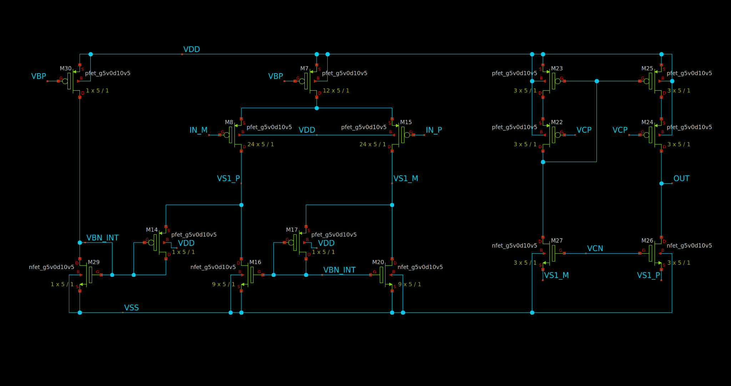
PMOS Input Opamp - Schematic

Slide 15
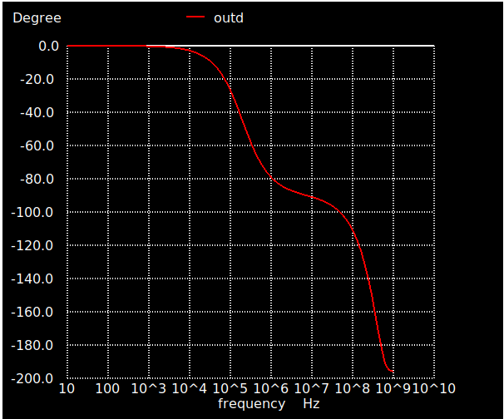
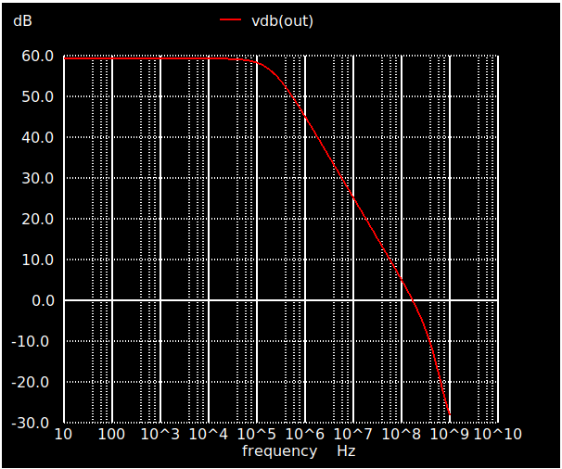
PMOS Input Opamp - Verification
Crossover Frequency of 180MHz and phase margin of 45 degrees with 700fF load capacitor

Slide 16
Design Process
Functional Units
NMOS input opamp
PMOS input opamp
Bias Circuits
Power Stage
Comparator
Design Blocks
Modulator
Oscillator
Switch Control
Current Sense

Slide 17
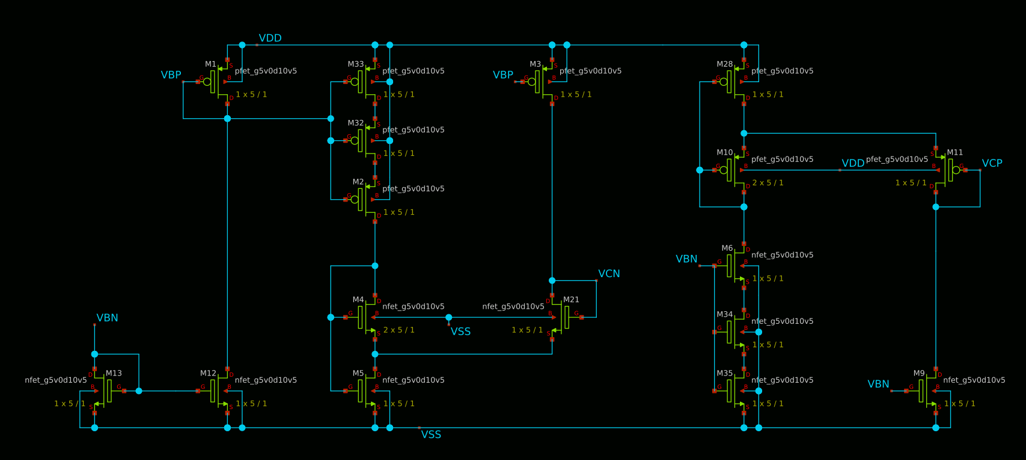
Bias Circuits
Generates cascode voltages from input bias current
Dedicated circuit for each opamp
B. A. Minch, "A low-voltage MOS cascode bias circuit for all current levels," 2002 IEEE International Symposium on Circuits and Systems. Proceedings (Cat. No.02CH37353), 2002, pp. III-III, doi: 10.1109/ISCAS.2002.1010300.

Slide 18
Design Process
Functional Units
NMOS input opamp
PMOS input opamp
Bias Circuits
Power Stage
Comparator
Design Blocks
Modulator
Oscillator
Switch Control
Current Sense

Slide 19
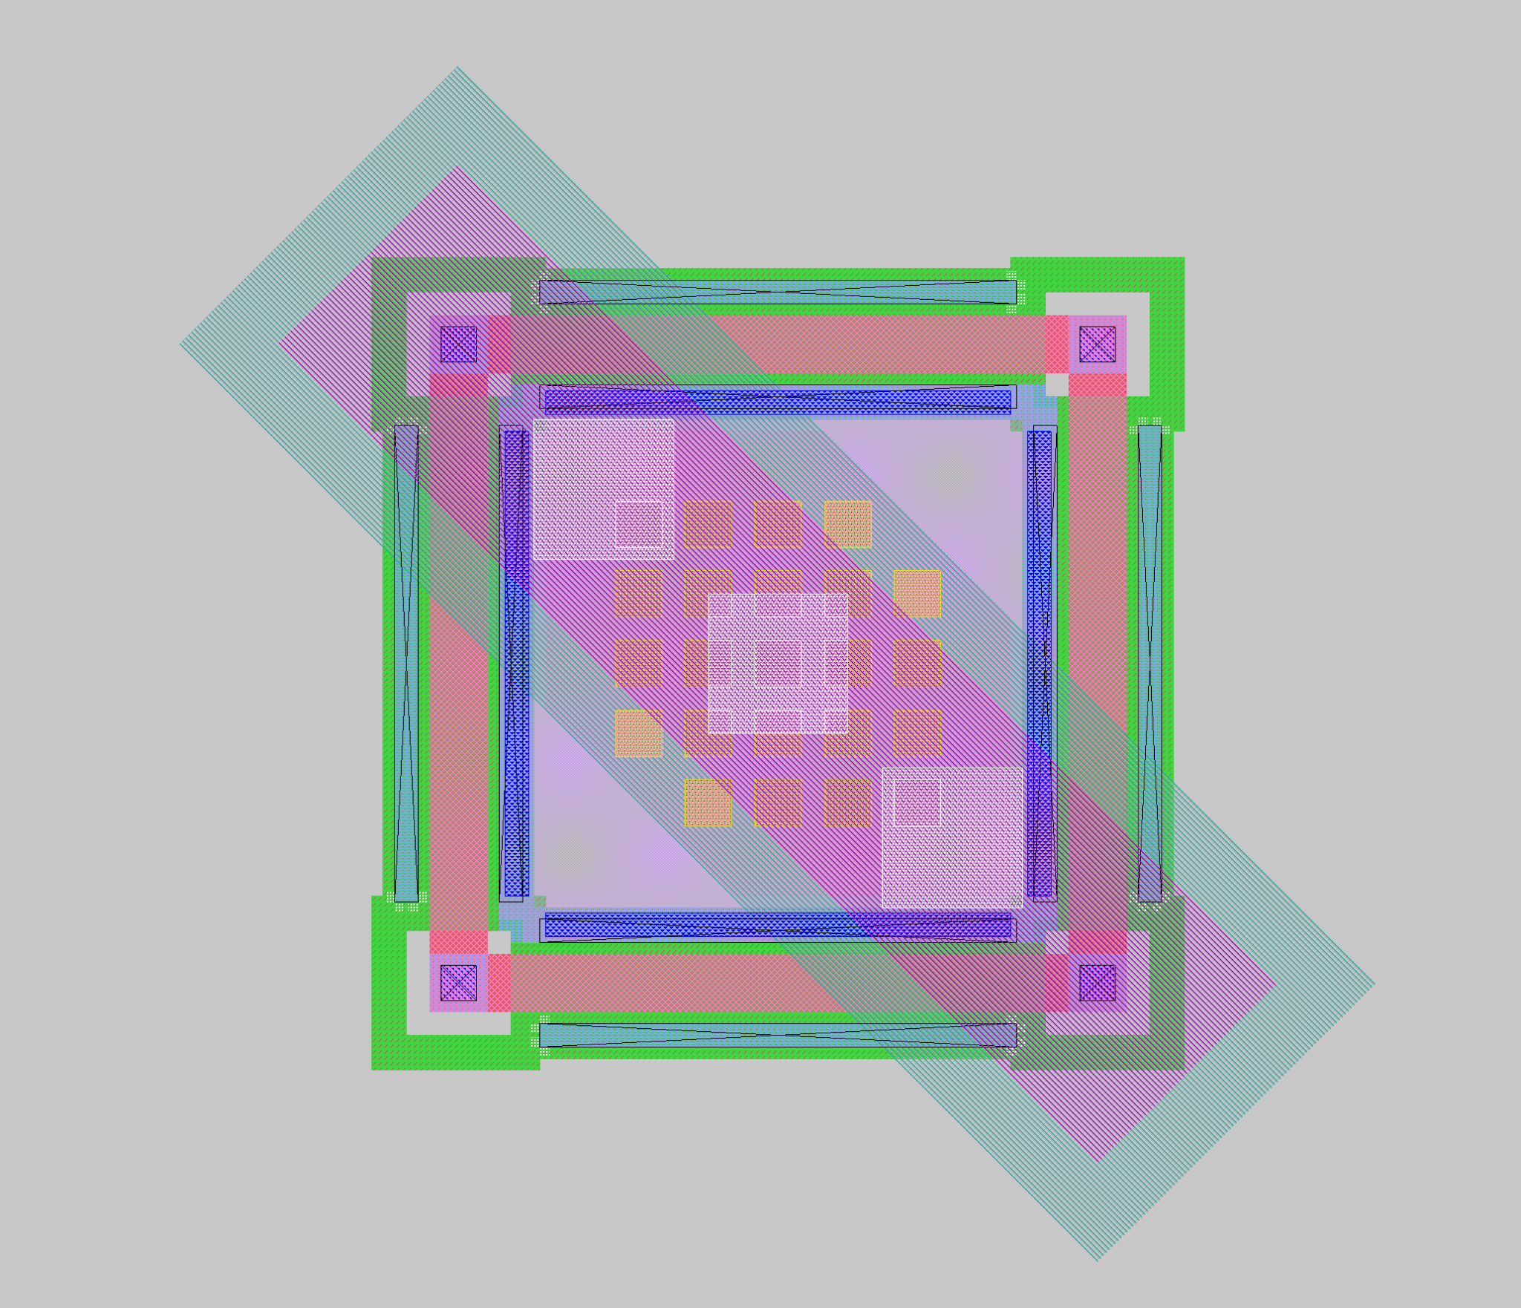
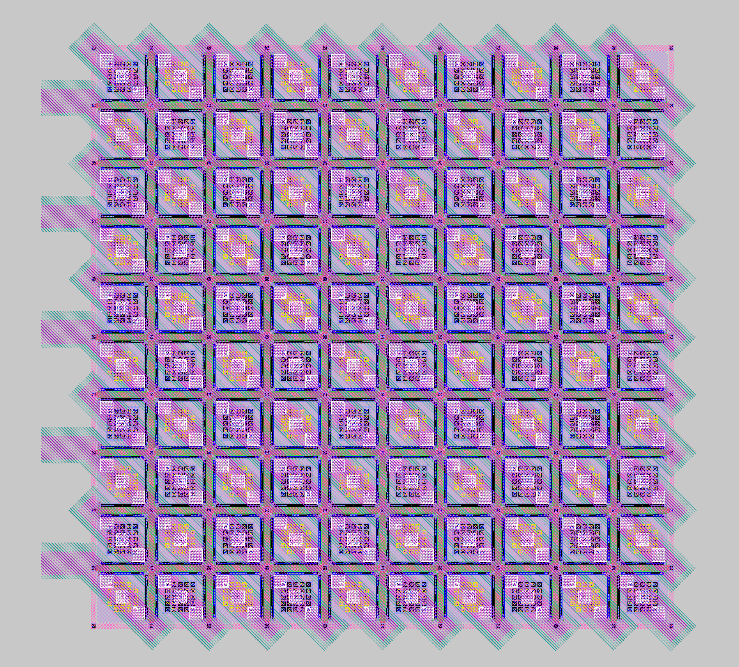
Power Stage - Hybrid Waffle FET
Power PMOS/NMOS implemented as repeating rectangular grid
Reduced routing resistance compared to normal finger design
Easy to generate array with script
36x36 cell array, unit cell pitch is 5.5um, channel width is 4.6um
2x PMOS array, 1x NMOS array
291mΩ PMOS, 176mΩ NMOS
Each array ~ 250um x 250um
A. Yoo, M. Chang, O. Trescases and W. T. Ng, "High Performance Low-Voltage Power MOSFETs with Hybrid Waffle Layout Structure in a 0.25μ Standard CMOS Process," 2008 20th International Symposium on Power Semiconductor Devices and IC's,

Slide 20
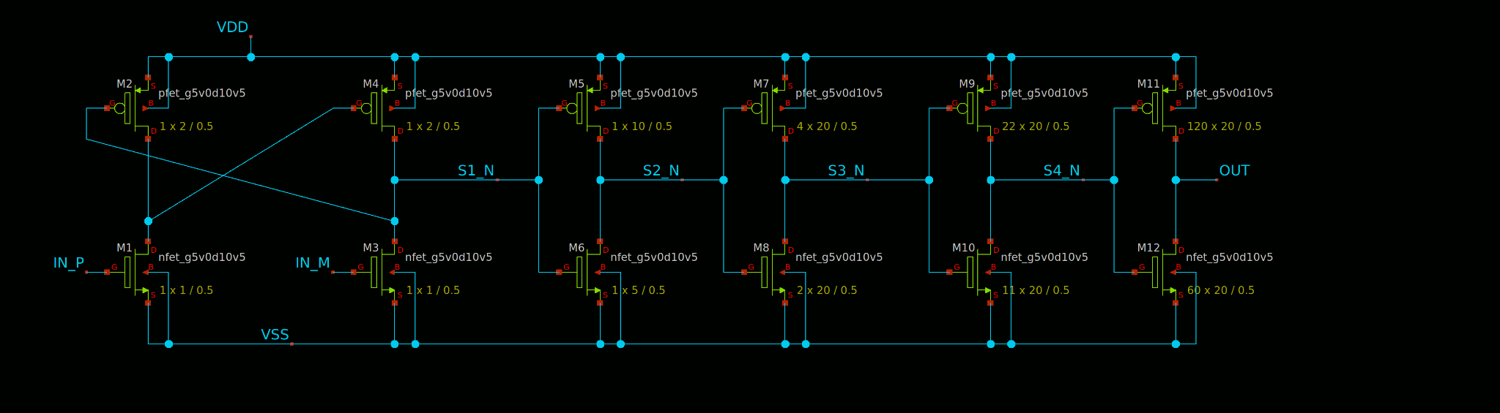
Power Stage - Gate Drive
Same gate drive circuit for differently sized PMOS and NMOS to save layout time
Tapered inverter chain with input level shifters to power section power supply
Driven by switch control block
Taper ratio of ~5.5

Slide 21
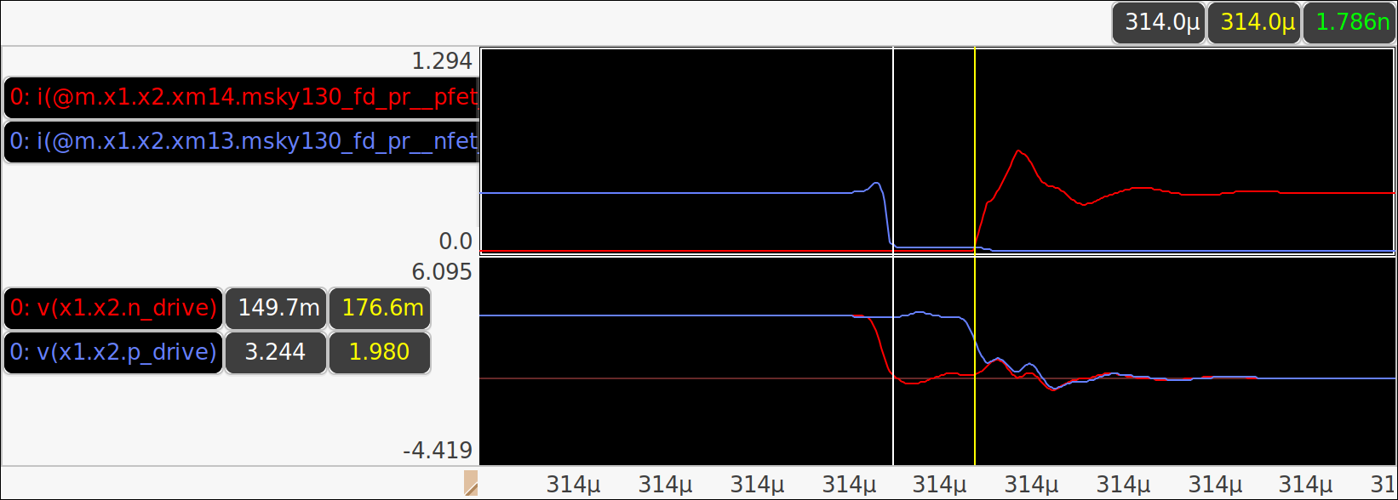
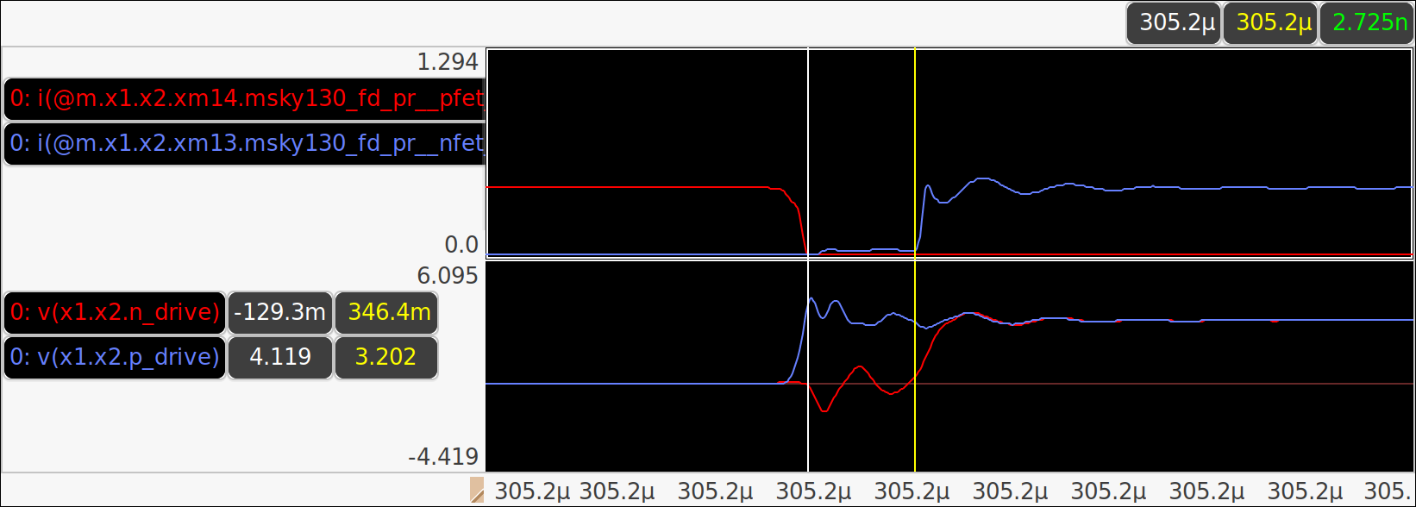
Power Stage - Verification
NMOS/ PMOS Currents
NMOS/ PMOS Gates
No overlap of gate drive waveforms, no shoot through of PMOS and NMOS.

Slide 22
Design Process
Functional Units
NMOS input opamp
PMOS input opamp
Bias Circuits
Power Stage
Comparator
Design Blocks
Modulator
Oscillator
Switch Control
Current Sense

Slide 23
Comparator
Continuous time comparator
Used in modulator
Hysteresis to filter out noise in switch control signal
Ability to respond fast enough relative to rate of change of input

Slide 24
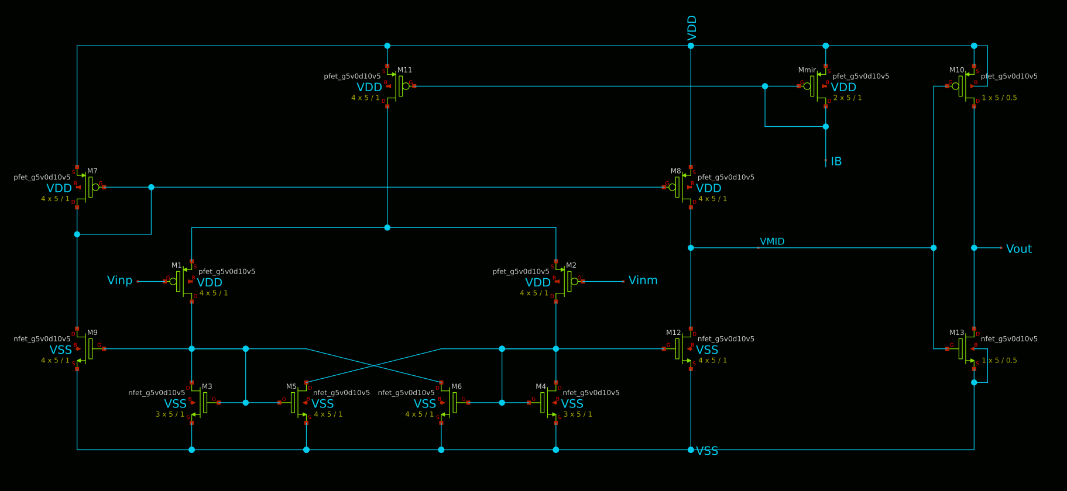
Comparator - Schematic
M1
M2
M3
M5
M6
M4

Slide 25
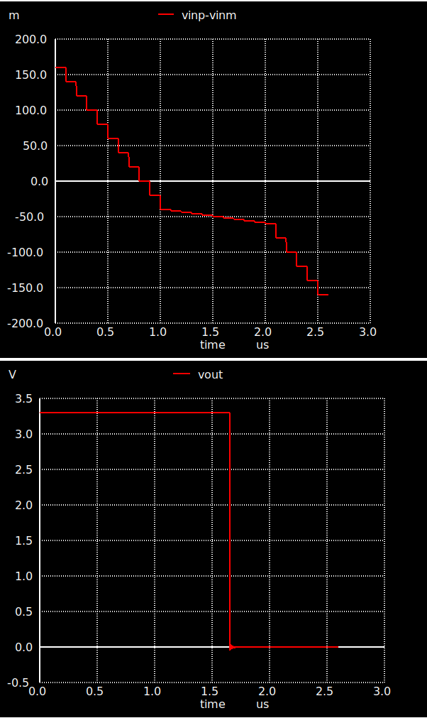
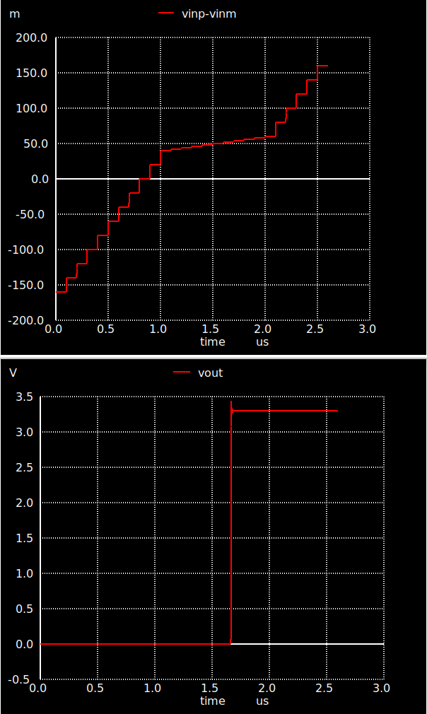
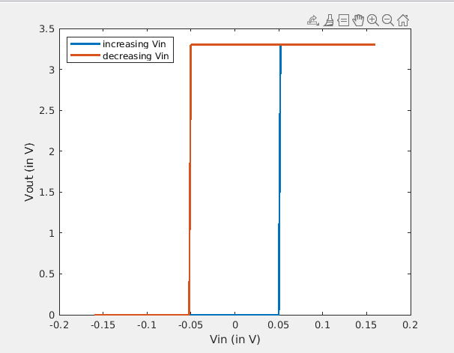
Comparator - Verification

Slide 26
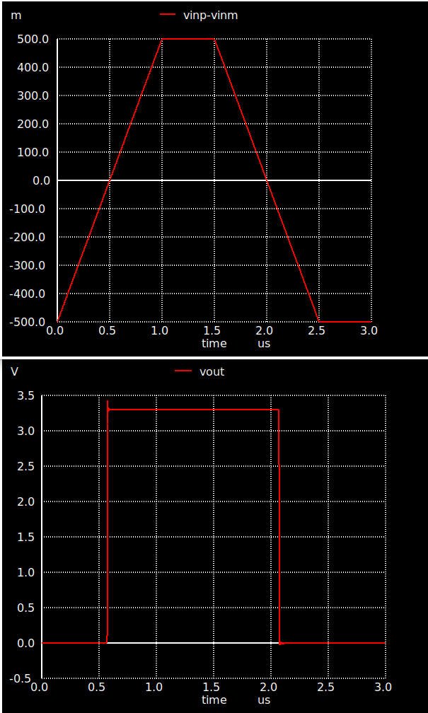
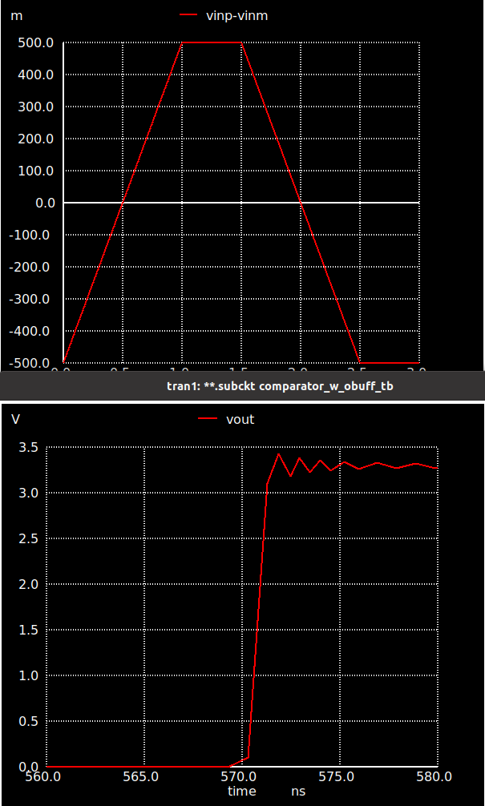
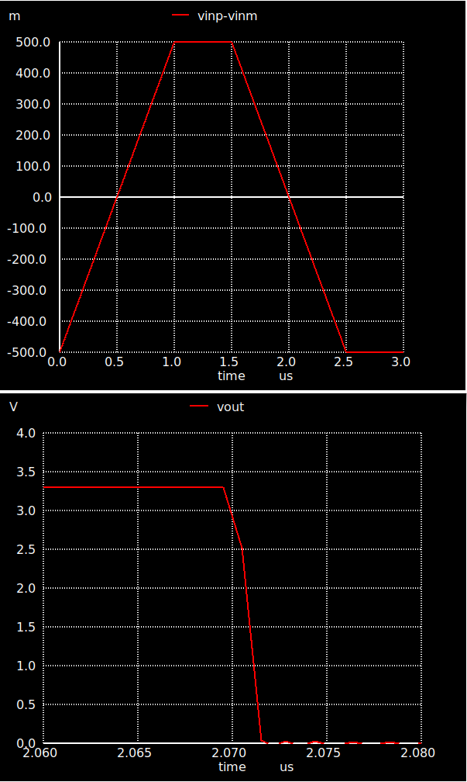
Comparator - Verification

Slide 27
Design Blocks

Slide 28
Design Process
Functional Units
NMOS input opamp
PMOS input opamp
Bias Circuits
Power Stage
Comparator
Design Blocks
Modulator
Oscillator
Switch Control
Current Sense

Slide 29
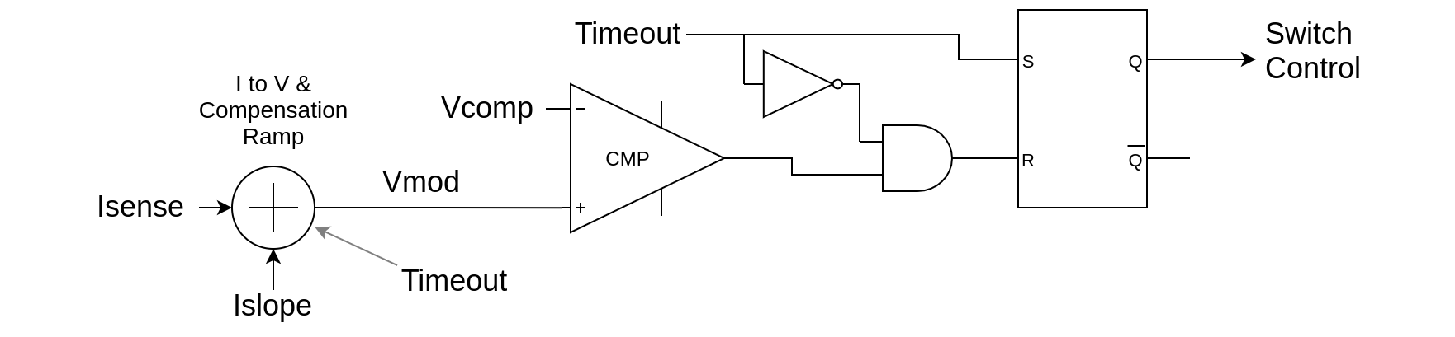
Modulator
Consists of two sub-parts - slope compensation & comparator
Slope compensation for the sensed current is required to prevent sub-harmonic oscillations
Comparator compares Vramp (output of slope compensation circuit) with Vcomp (output of Vref - Vfb error amplifier)
Output of modulator determines when power PMOS turns off

Slide 30
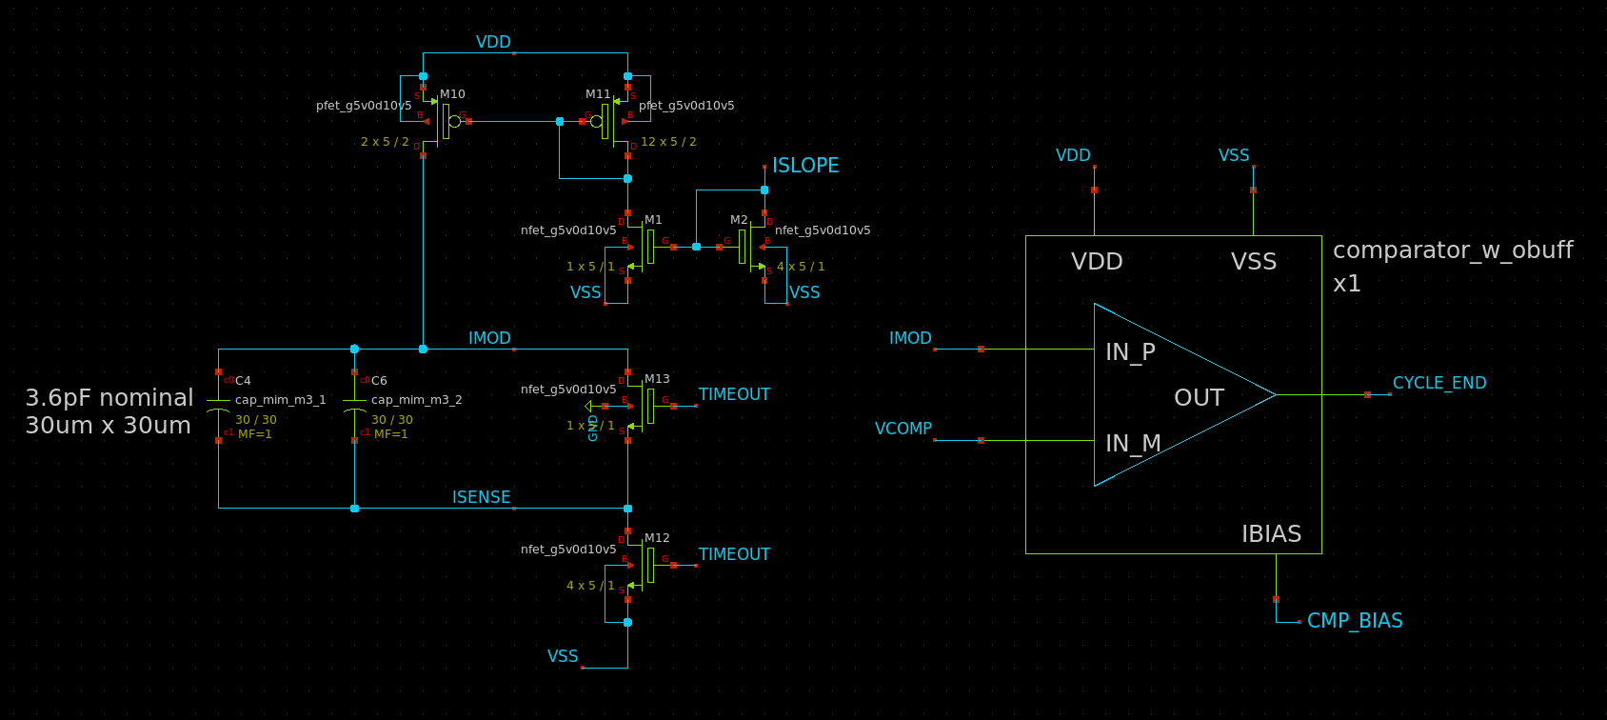
Modulator - Schematic

Slide 31
Design Process
Functional Units
NMOS input opamp
PMOS input opamp
Bias Circuits
Power Stage
Comparator
Design Blocks
Modulator
Oscillator
Switch Control
Current Sense

Slide 32
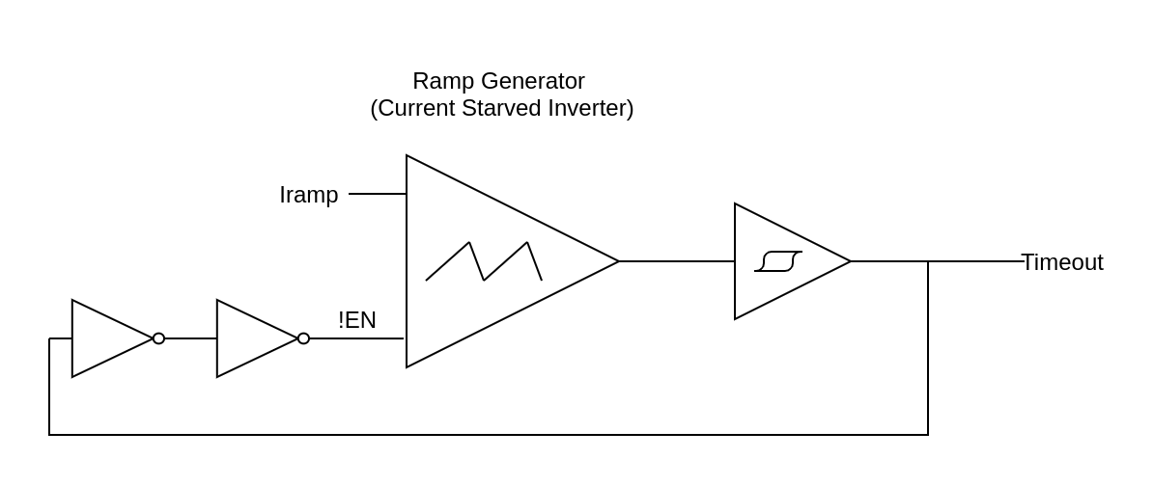
Oscillator
Consists of ramp generator and Schmitt trigger
Ramp generator is constructed using a off-chip current source and current starved inverter with capacitor at the output
Designed for 5MHz to have reasonable value of current and capacitor for ramp generator. Need to add frequency division circuitry
Output of modulator determines when power PMOS turns off

Slide 33
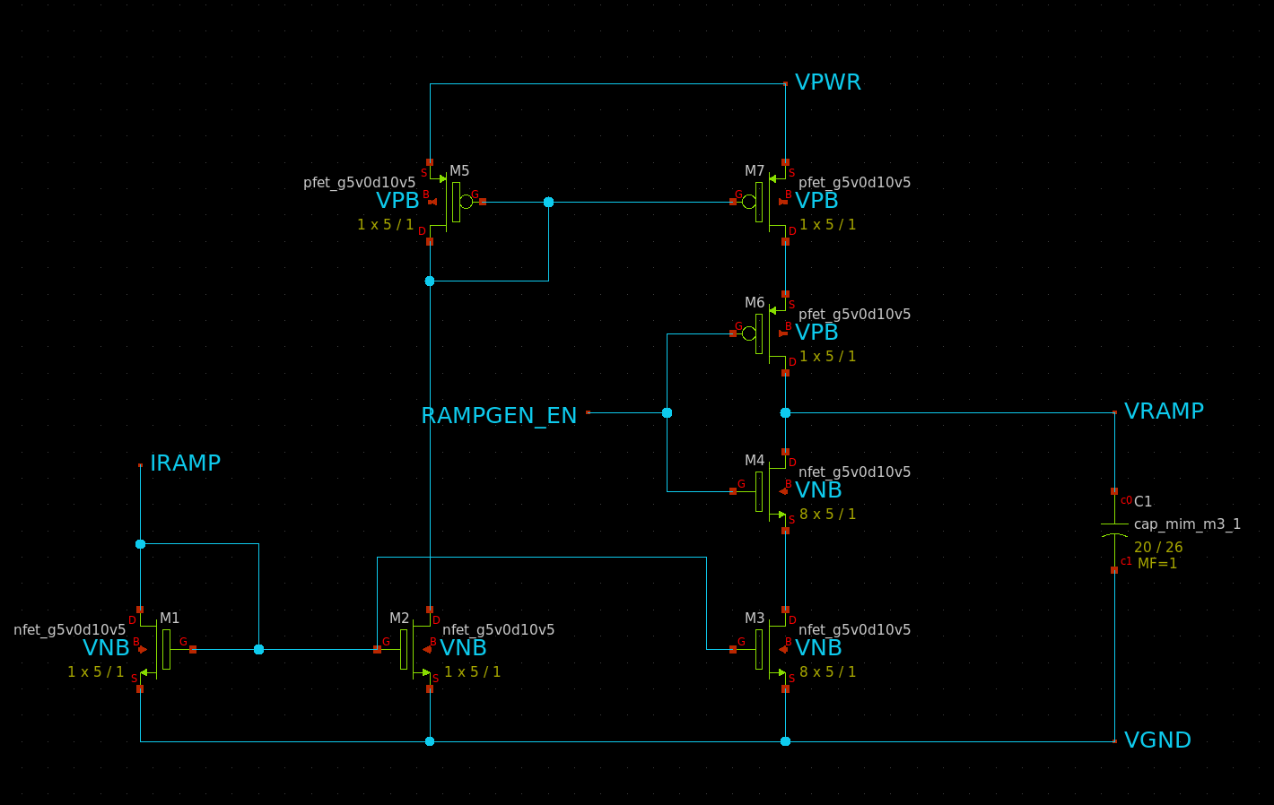
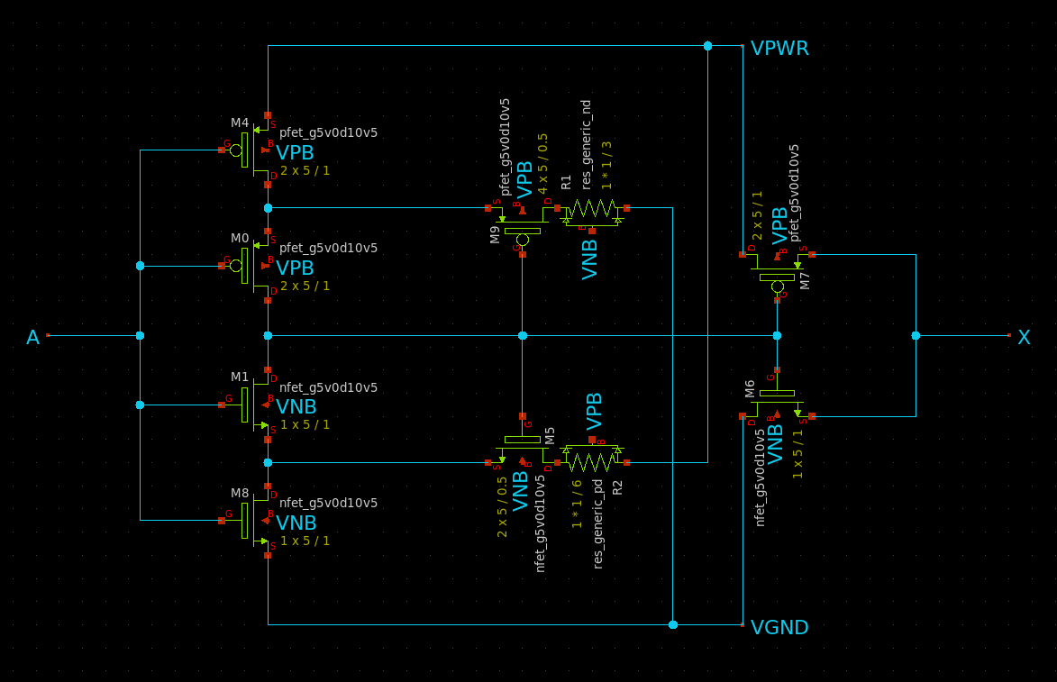
Oscillator - Schematic
Ramp Generator
Schmitt Trigger

Slide 34
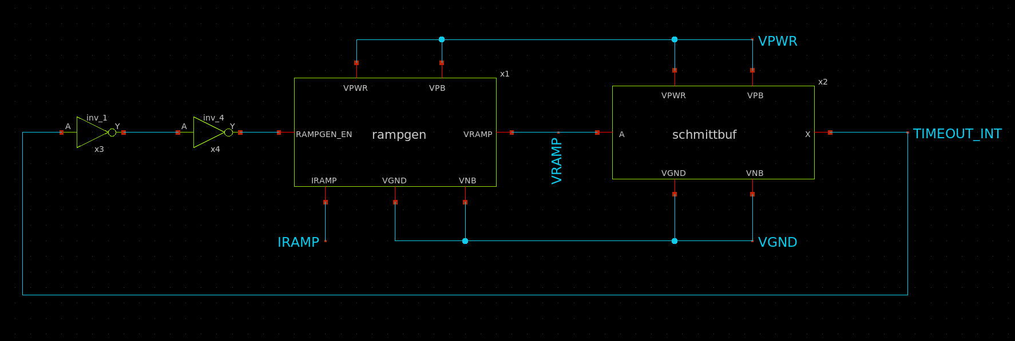
Oscillator - Schematic
Overall

Slide 35
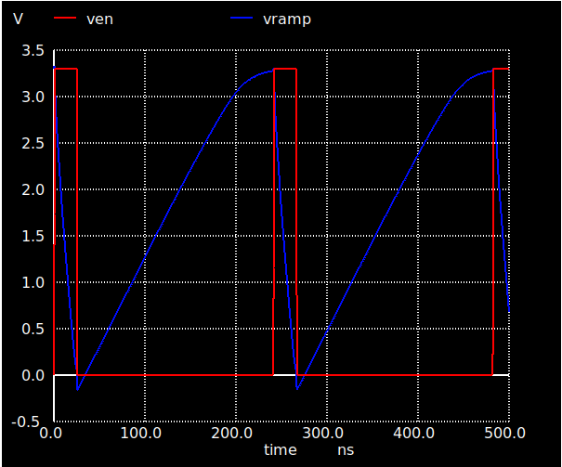
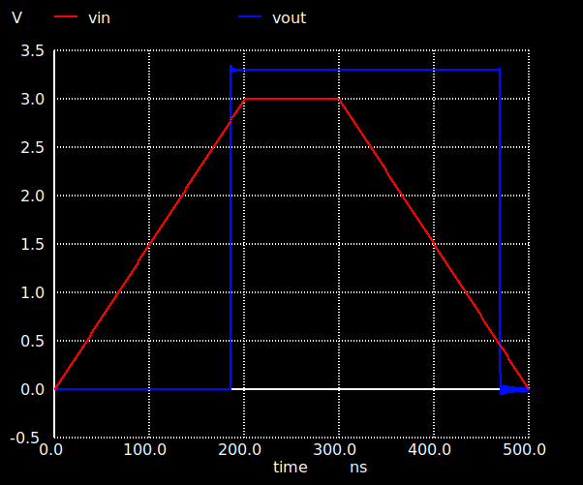
Oscillator - Validation
Ramp Generator
Schmitt Trigger

Slide 36
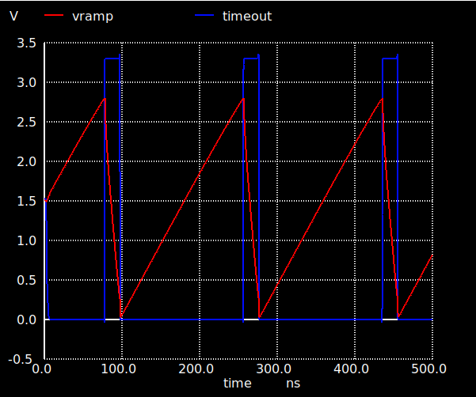
Oscillator - Validation
Overall

Slide 37
Design Process
Functional Units
NMOS input opamp
PMOS input opamp
Bias Circuits
Power Stage
Comparator
Design Blocks
Modulator
Oscillator
Switch Control
Current Sense

Slide 38
Switch Control
Single digital block for the project
Currently hand chosen gates, working on porting to verilog for automated P&R
Muxes for debug control signals
Inverter chain to provide deadtime
SR latch for switch control
Uses sky130_fd_sc_hvl cell library to run off same power supply as other components

Slide 39
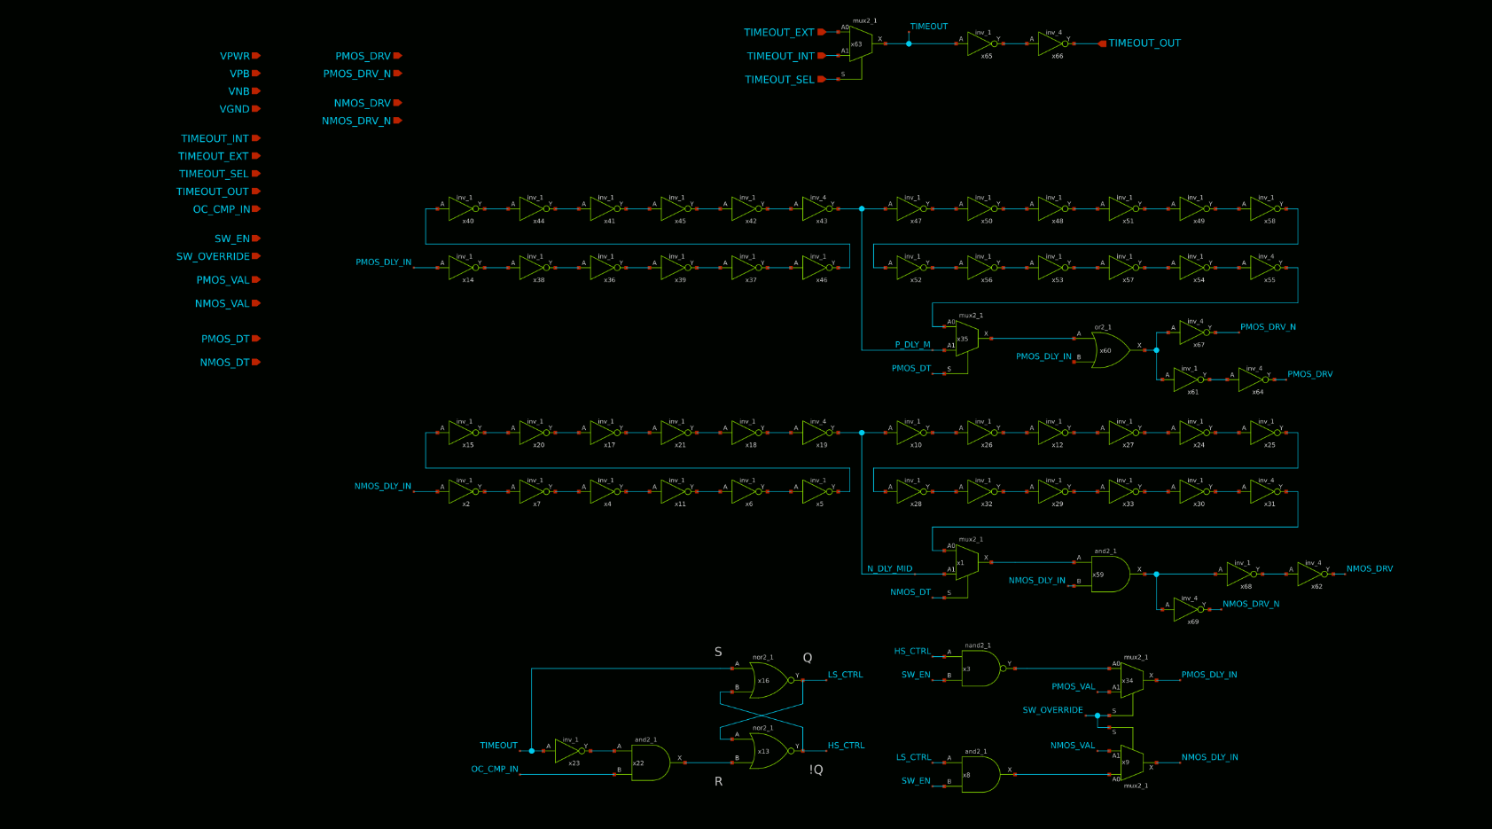
Switch Control - Schematic

Slide 40
Design Process
Functional Units
NMOS input opamp
PMOS input opamp
Bias Circuits
Power Stage
Comparator
Design Blocks
Modulator
Oscillator
Switch Control
Current Sense

Slide 41
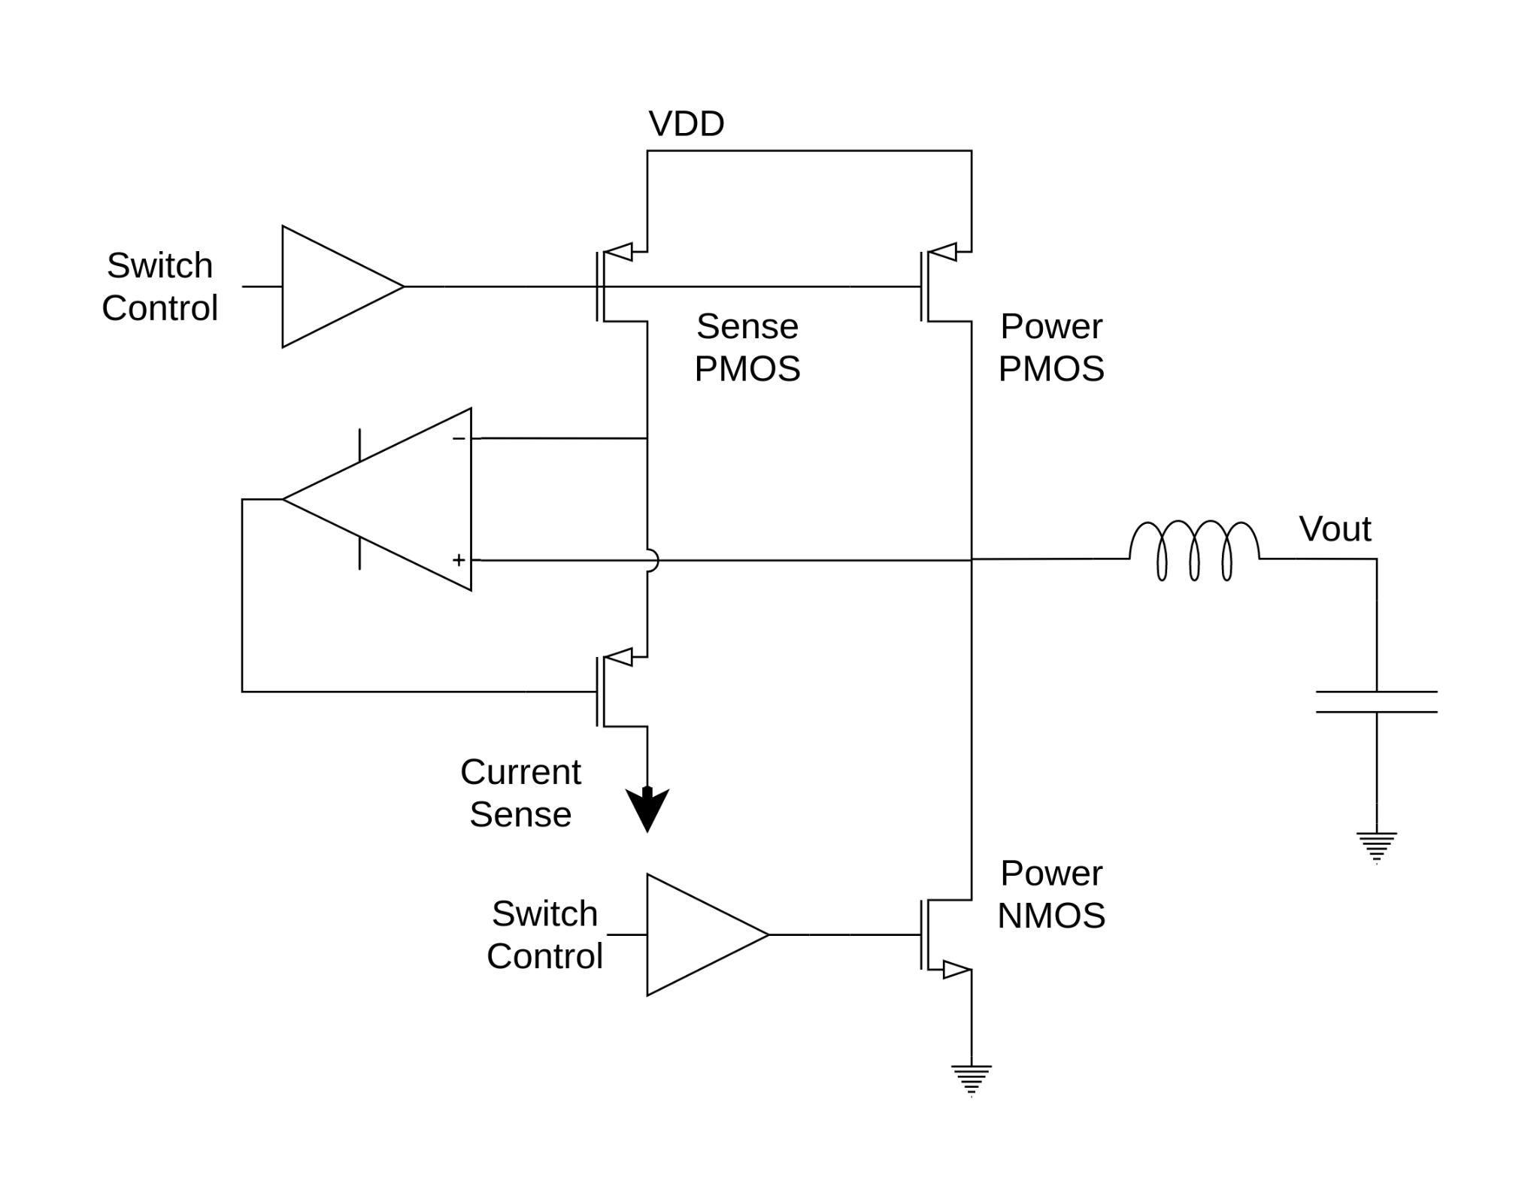
Current Sense
Opamp forces equal voltage drop across sense and power PMOS (equal current density)
Our design uses addition current mirrors to supply off-chip current signal for testing
Nominal sensitivity of 1.3V/A

Slide 42
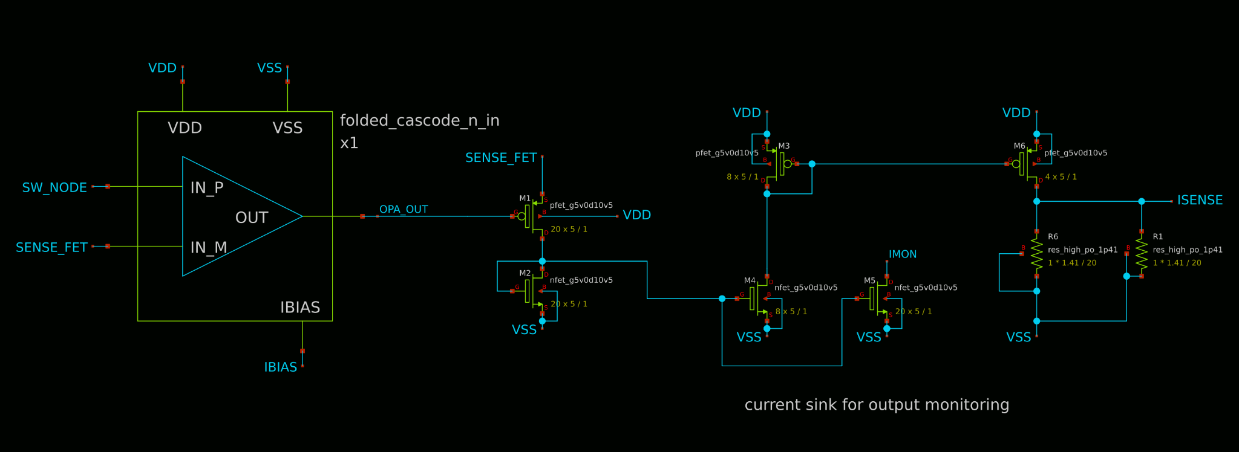
Current Sense - Schematic

Slide 43
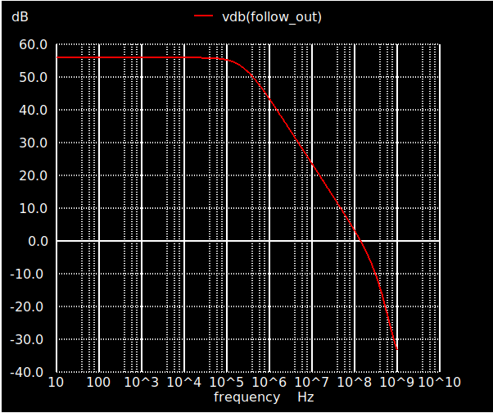
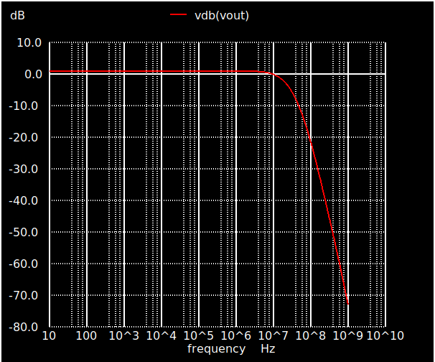
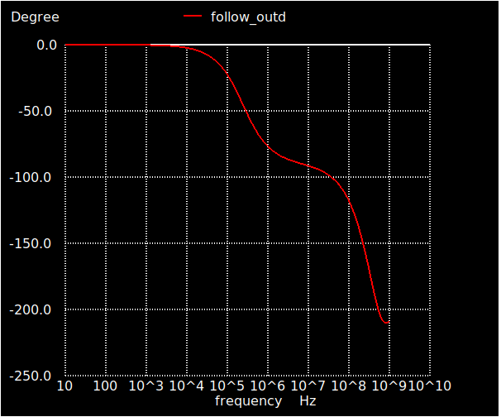
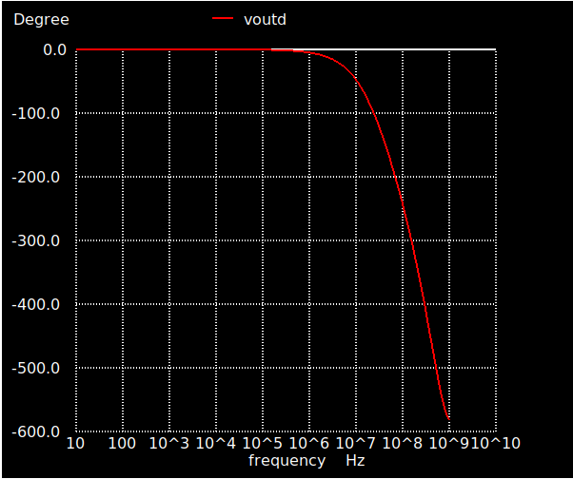
Current Sense - Small Signal Validation
Open Loop Response: Phase margin of 45 degrees
Closed Loop Response: -3dB point at 18MHz
Open Loop Frequency Response
Closed Loop Frequency Response

Slide 44
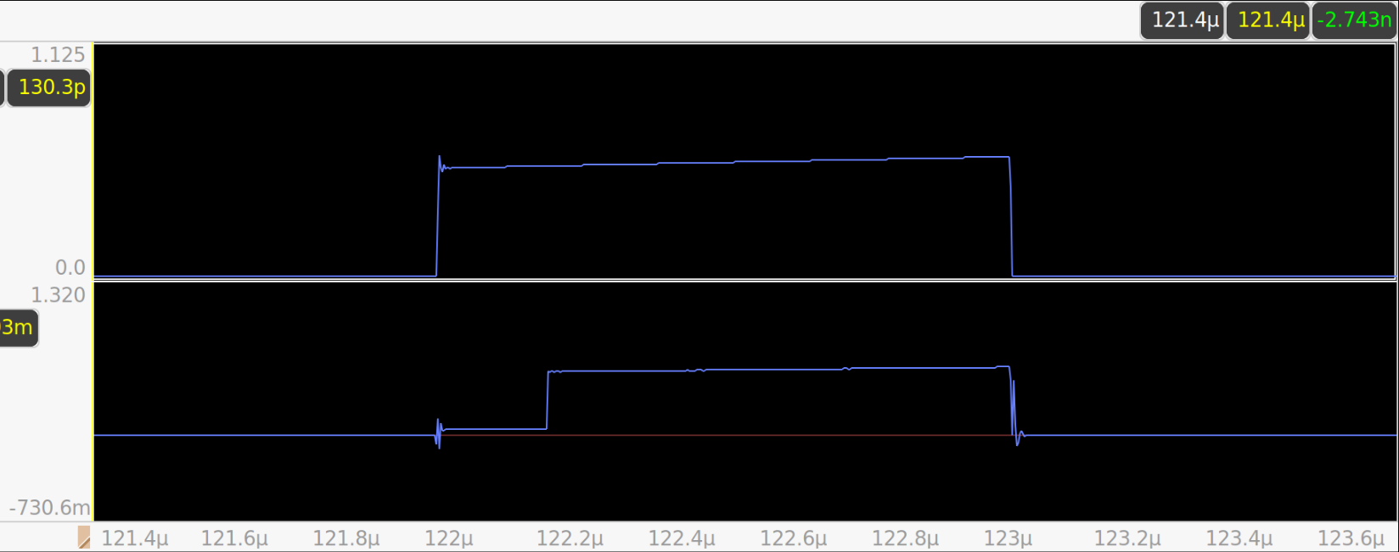
Current Sense - Transient Simulation
Step in signal due to blanking of current signal during switching transition
Top: Power PMOS Current
Bottom: Current Sense Signal

Slide 45
System Level

Slide 46
System Level Tests
Simulation of system to measure regulation and transient response
Simplified models of IO pads, package inductance, and power components
Test across process corners and temperature range
AN-1205 Electrical Performance of Packages https://www.ti.com/lit/an/snoa405a/snoa405a.pdf

Slide 47
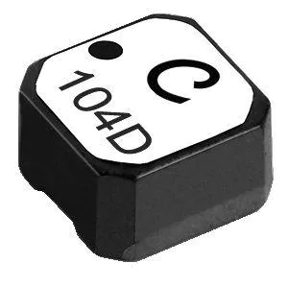
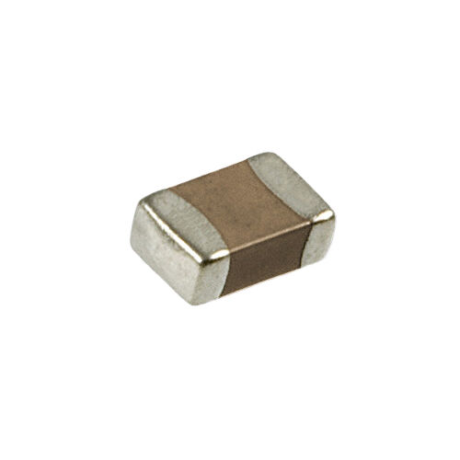
System Level - Interface and External Components
IO Pads simplified as 150 ohm ESD resistor + 6pF for ESD diodes and redistribution layer capacitance
1nH common ground inductance
2nH pin inductance
Parasitic models for power inductor and decoupling capacitors

Slide 48
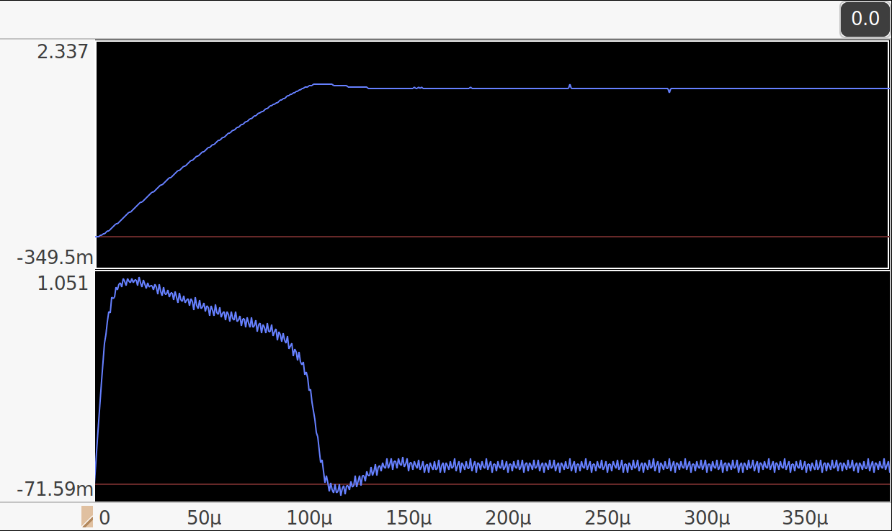
System Level - Transient Response
Peak output voltage of 1.85V (50mV overshoot)
Peak inductor current limited to 1A by clamping compensator voltage
Reaches steady state in 150uS
Output Voltage
Inductor Current

Slide 49
System Level - Efficiency
Simulated at 70C and SS process corner
3.3V in, 1.8V out
Interconnect resistance for power stage not modeled (up to ~50% more power stage loss)
Output Power | Power Stage Loss | Bias / Control Power | Efficiency
0.1W | 3.2mW | 3.5mW | 93.7%
0.2W | 7.2mW | 3.7mW | 94.9%
0.5W | 40.5mW | 4.1mW | 91.8%

Slide 50
Debug / Bringup
Current sense output off-chip via current mirror
Control registers for switch control to adjust control time and manually control switch state
Oscillator can be bypassed with off-chip timeout signal
Slope compensation, oscillator control, and analog bias current as separate bias currents from off-chip

Slide 51
Summary / Further Tasks
Individual modules verified
System validated on temperature and process corners
Next steps
laying out individual components and parasitic extraction
Porting logic gate layout to verilog for P&R
Second pass ESD structures
Focus on impact of parasitics on power stage resistance and on opamp frequency response

Slide 52
Full Schematics

Slide 53
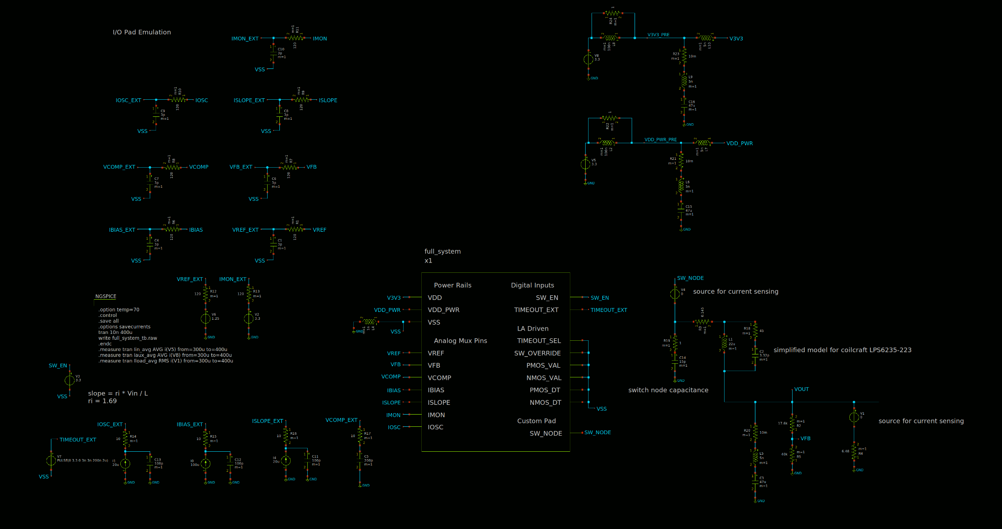
Top Level Testbench

Slide 54
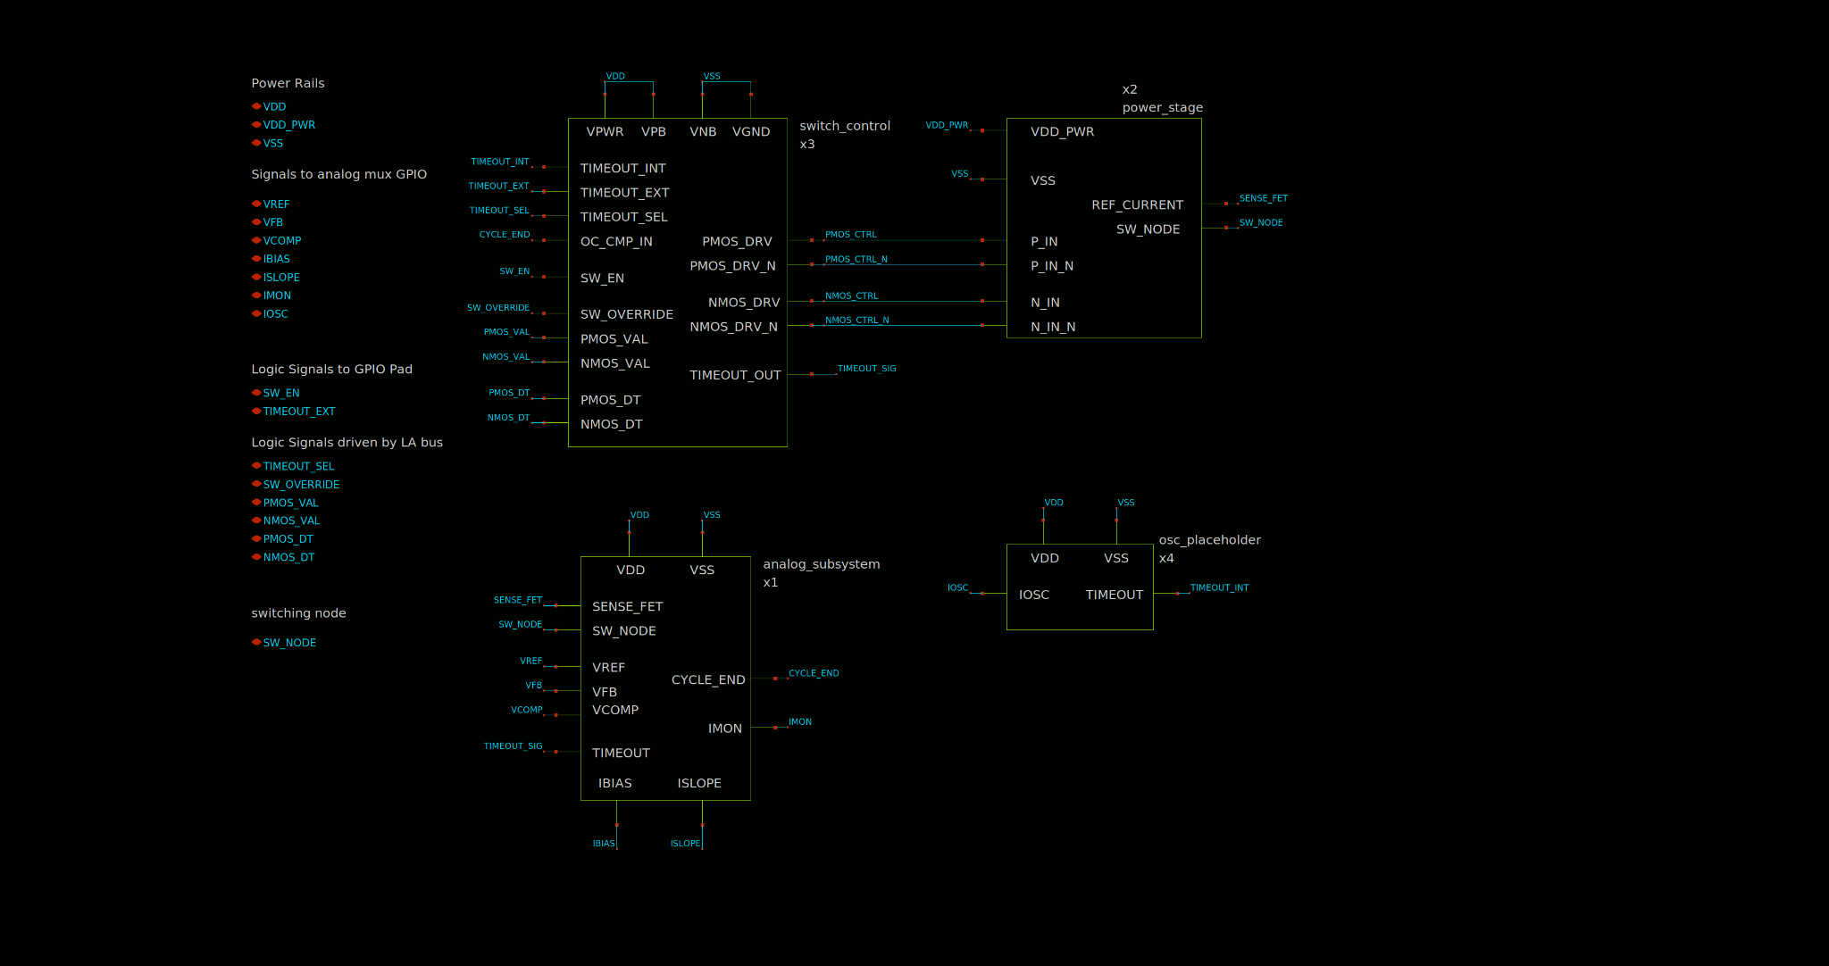
Top Level Module

Slide 55
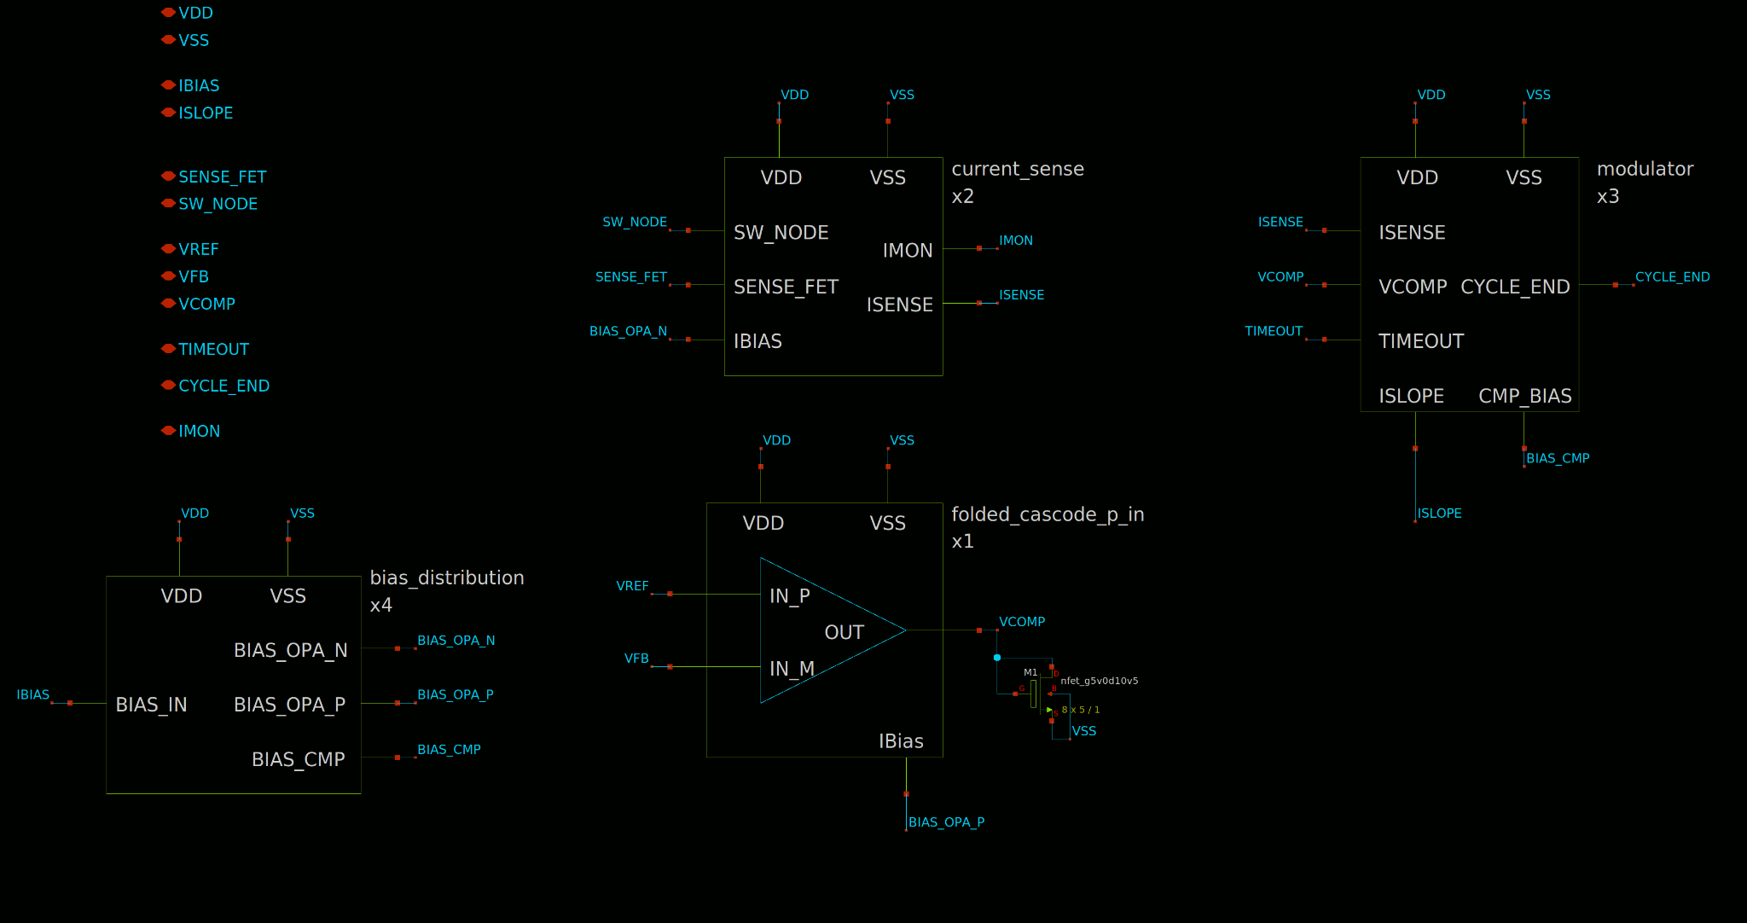
Analog Module

Slide 56
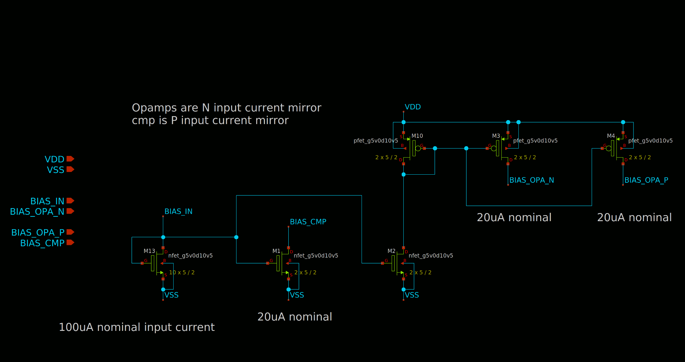
Bias Distribution

Slide 57
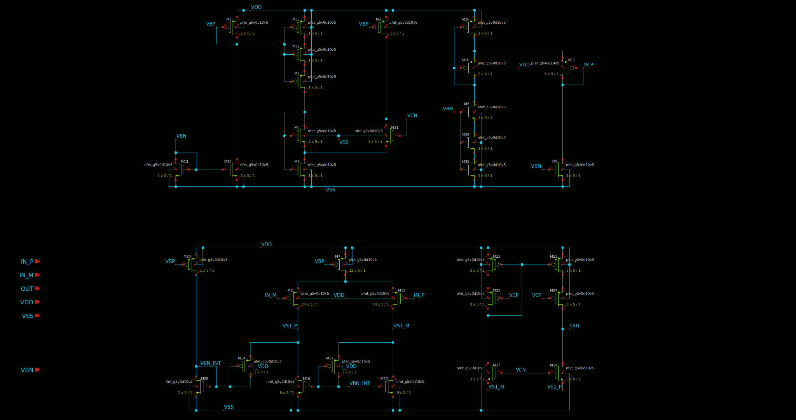
PMOS Folded Cascode

Slide 58
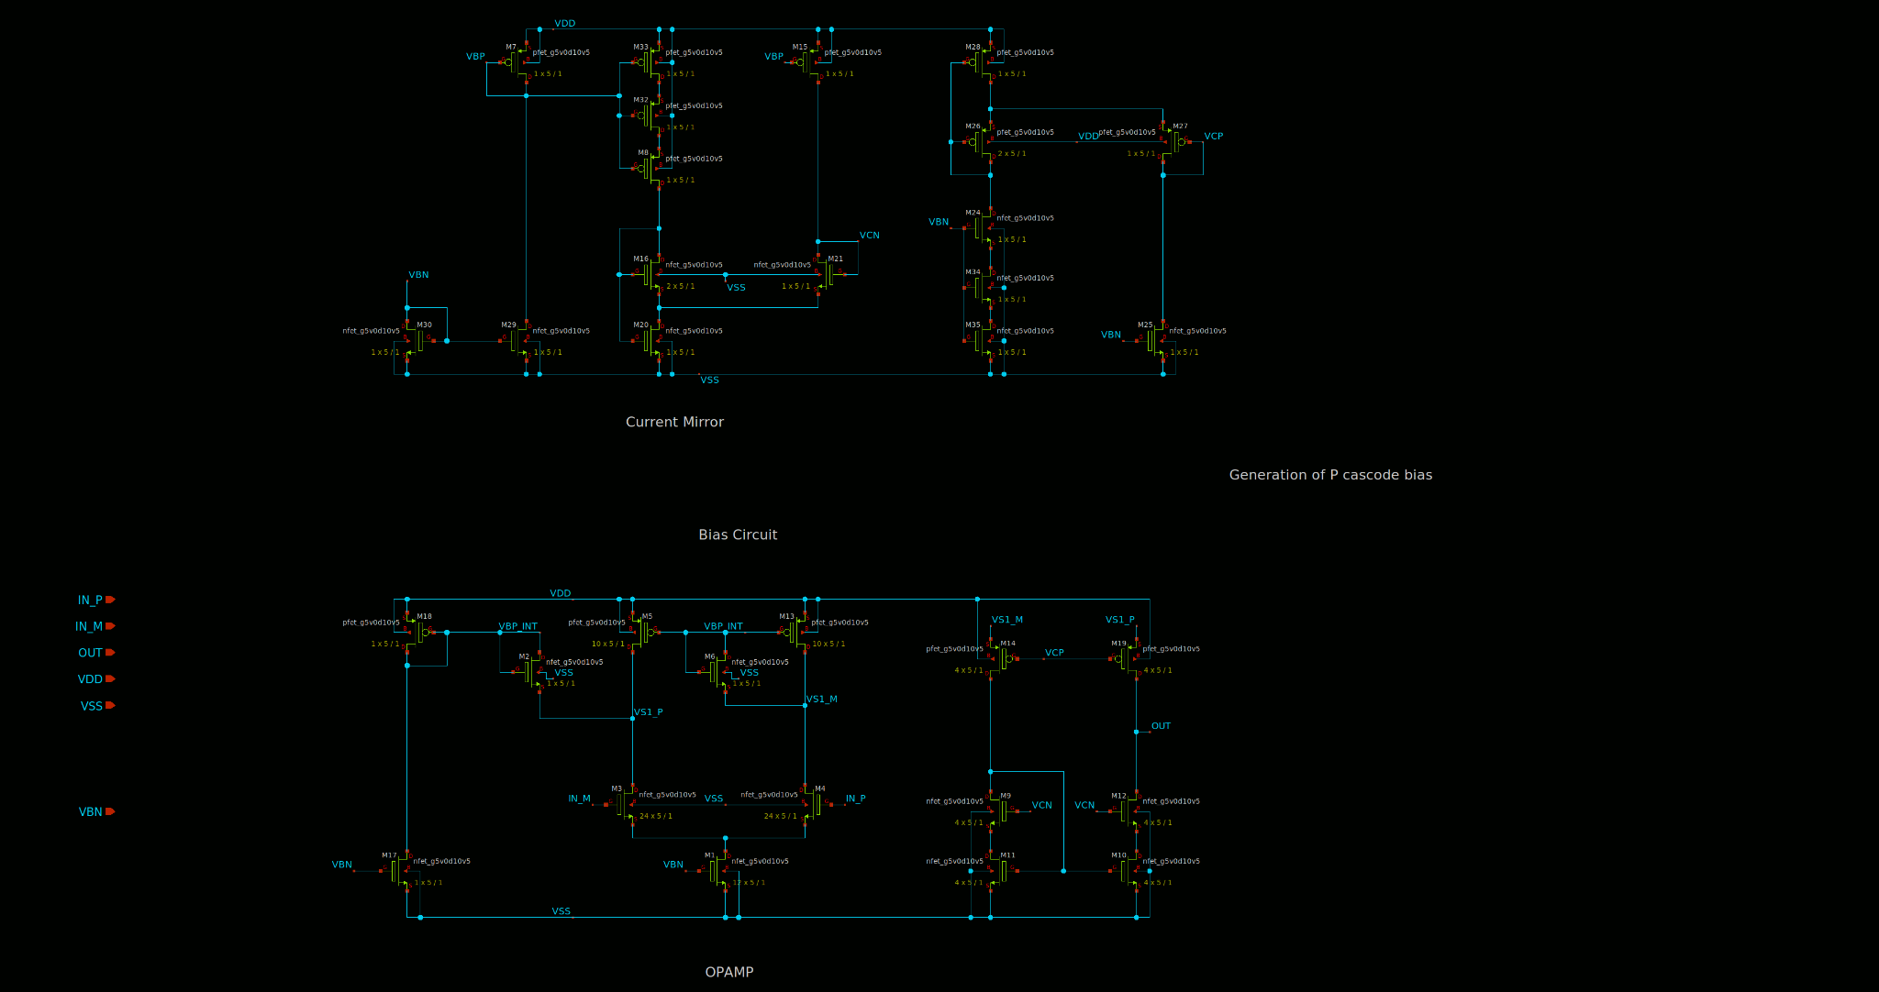
NMOS Folded Cascode

Slide 59
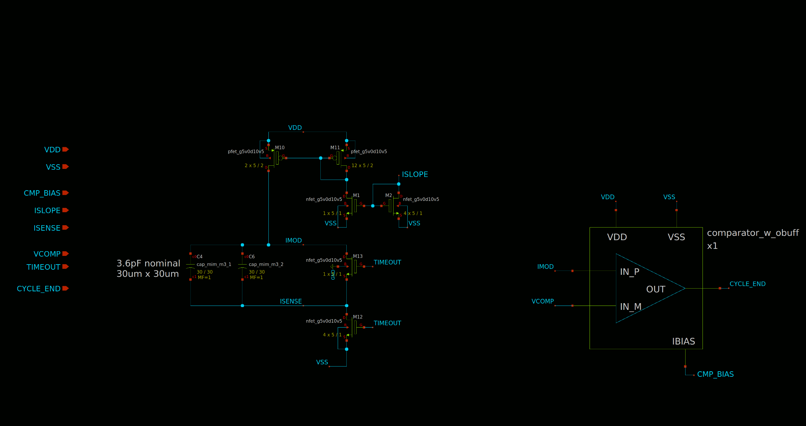
Modulator

Slide 60
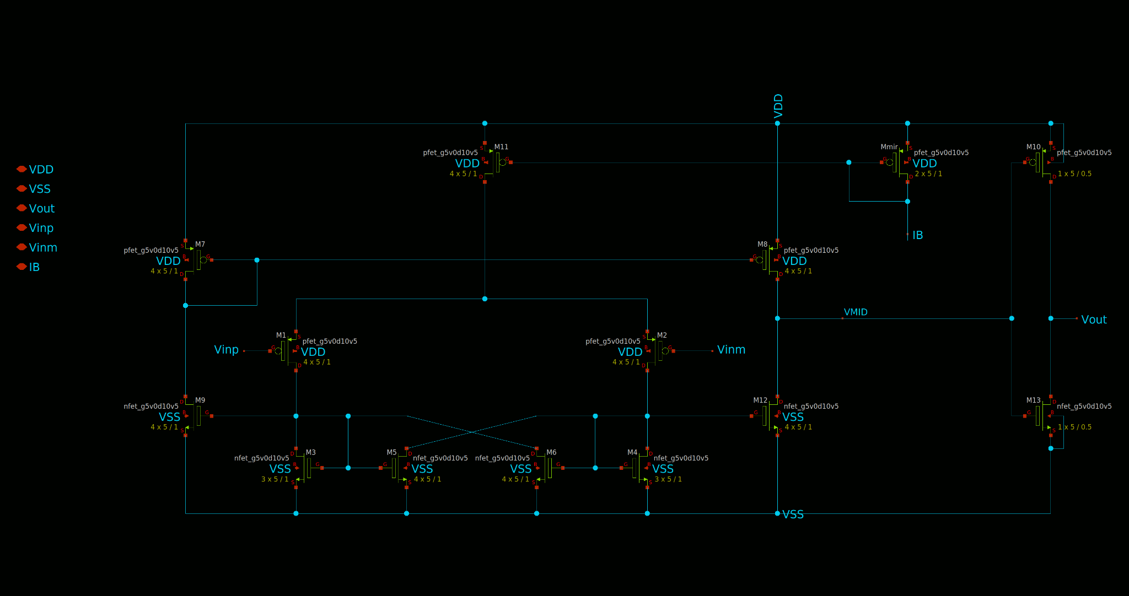
Comparator

Slide 61

Power Stage

Slide 62
Gate Drive

Slide 63

Switch Control

